Slide 1

Choosing a Honda

Slide 2
Consideration On Choosing a Honda Car
Price
2. Performance
3. Seating Capacity
Press me
Press me
Press me

Slide 3
Price
$60 000 - $70 000
2. $70 000 - $90 000
3. $90 000 - $100 000
Press me
Press me
Press me

Slide 4
Performance
1300cc to 1500cc
2. 1600cc to 2000cc
3. 2000cc to 2400cc
Press me
Press me
Press me

Slide 5
Seating Capacity
1 – 4 pax
2. 1 – 5 pax
3. 1 – 7 pax
Press me
Press me
Press me

Slide 6
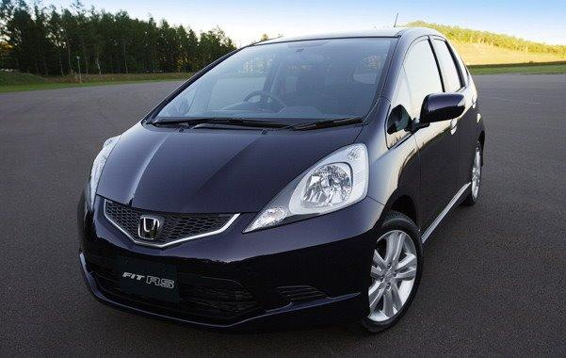
Honda Jazz
Back

Slide 7
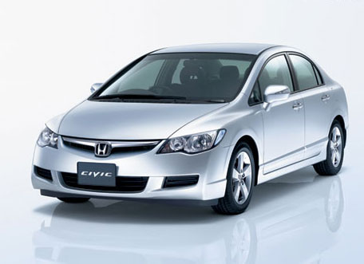
Honda Civic
Back

Slide 8
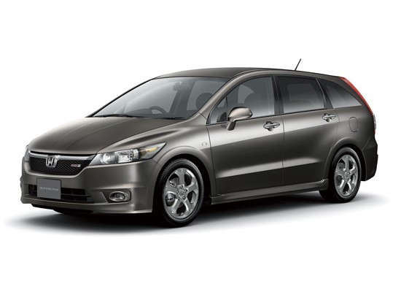
Honda Stream
Back

Slide 9
The End

