Slide 1
Groups of Reptiles
Lizards and Snakes
  Have legs & clawed toes (lizards) external ears, moveable eyelids
  Highly evolved specialized forms (venom)
Crocodiles and Alligators
  Long, typically broad snout and squat appearance
  All are carnivorous
  Protective of young; carry hatchlings in their mouth
  Live in tropics and subtropics
  Alligators live in freshwater
  Crocodiles live in fresh or saltwater

Slide 2
Groups of Reptiles (con.)
Turtles and Tortoises –
  All are shelled
  Turtles are aquatic; tortoises are terrestrial
Tuatara –
  Primitive reptiles found on small, remote islands

Slide 3
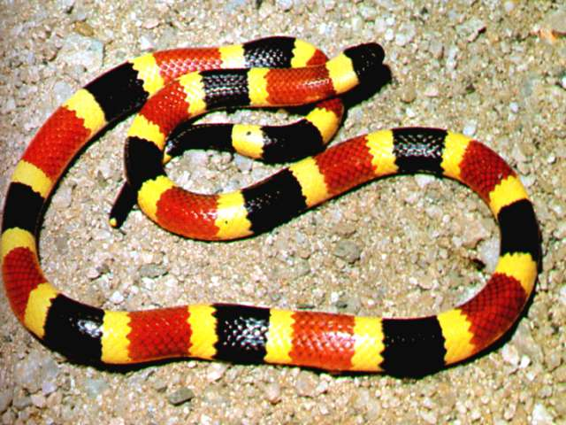
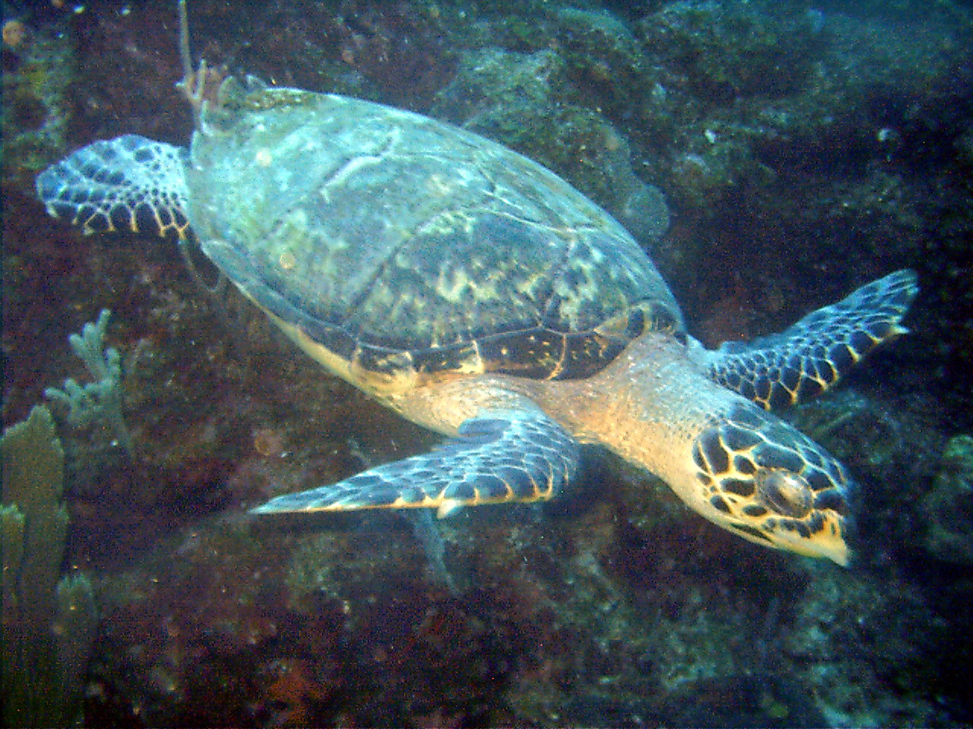
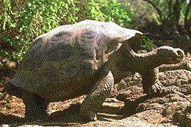
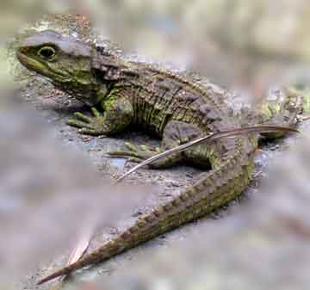
Coral Snake
Sea Turtle
Galapagos Tortoise
Tuatara

Slide 4
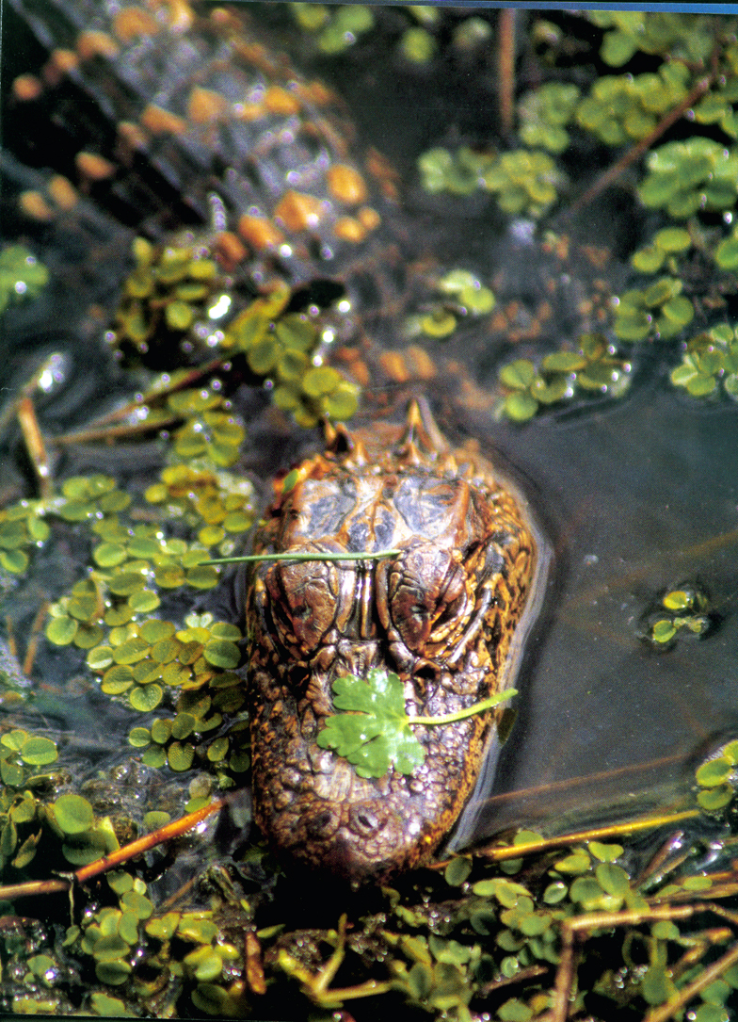
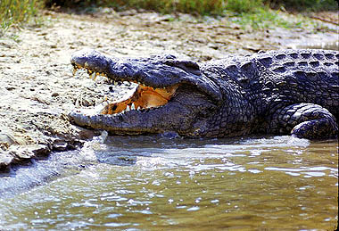
Nile Crocodile
North American Alligator

