Slide 1
Hard research On Impervious Surfaces
By: Caleb Bageant, Derek Brenneman, “Ninja” Nick Tabidze, and Antonio Sanchez

Slide 2
The dirt on impervious surfaces
What is an impervious surface?
  Impervious:“not permitting penetration or passage; impenetrable: The coat is impervious to rain.”
  Surface: “any face of a body or thing: the six surfaces of a cube.”
  “Impervious urban surfaces are ‘desert-like’ in terms of hydrology and micro-climate.”

Slide 3
Land Use
Humans use land in many different and productive ways. Some ways in Berkely County area are:
  Parks and recreational facilities
  Schools
  Roads
  Stores
  Houses
  Farms
  Orchards
  Farms alone cover 3,378,452 acres of land in WV.

Slide 4
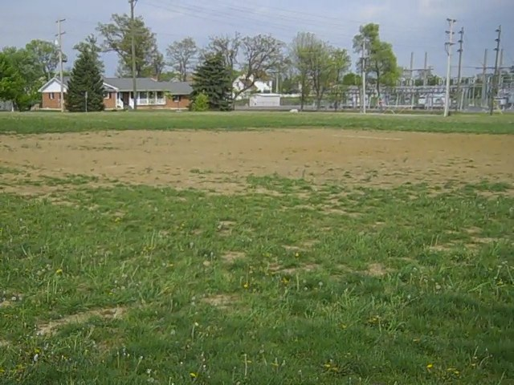
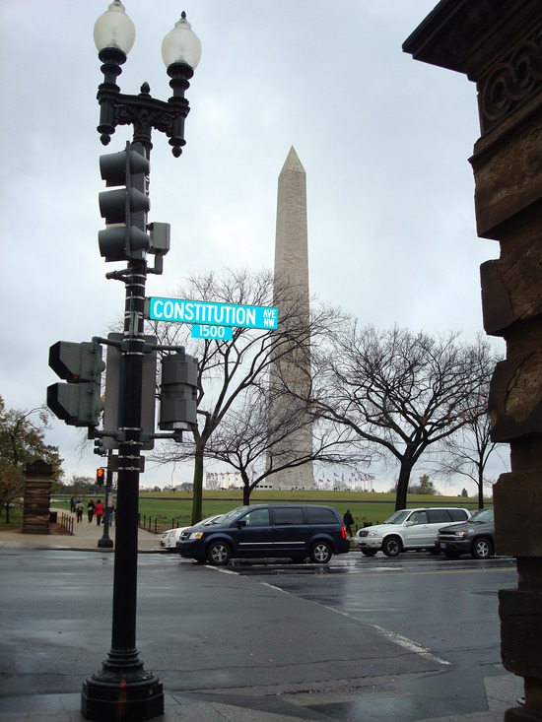
This field has been packed down so much that it is an impervious surface.
The road, sidewalk and Washington Monument are all impervious surfaces.

Slide 5
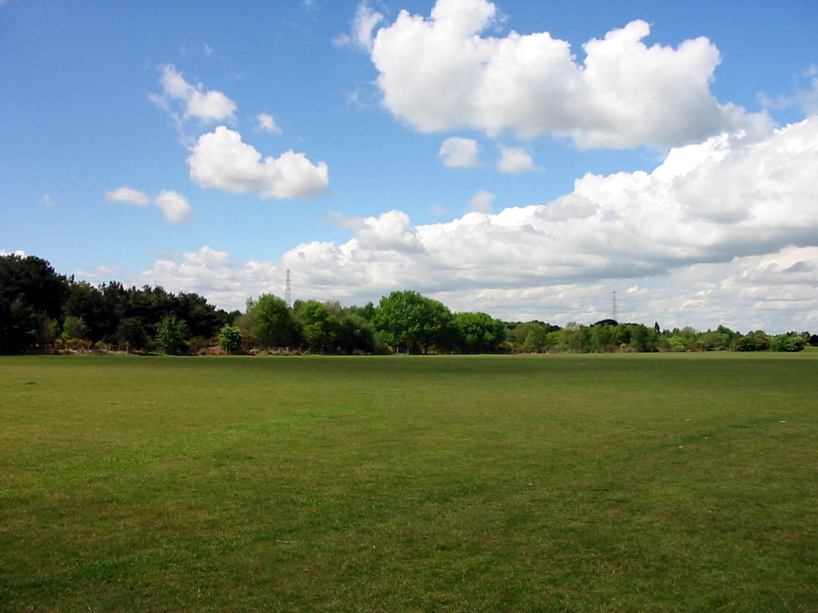

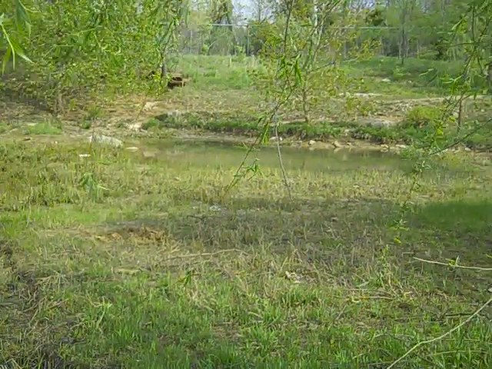
This field is not an impervious surface
This picture of MHS water shed is not an impervious surface

Slide 6
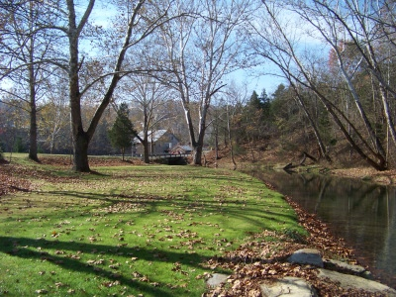
The part of Mill Creek shown is not an impervious surface.

Slide 7
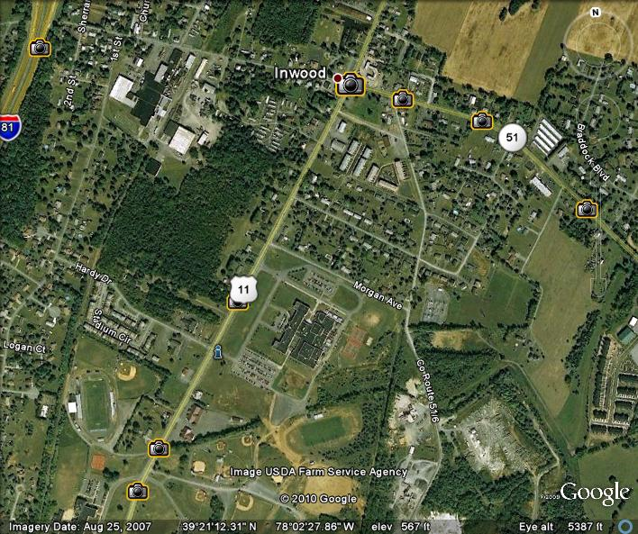

Slide 8
Watershed Data
Mill Creek: (Data taken Nov. 6 2009)
  Temperature: 5.5º Celsius
  pH: 7.5
  Conductivity: 680 US
  Dissolved Oxygen: 10 PPM
  Nitrate/Nitrite: 0 PPM
  Alkalinity: 275 PPM
  Turbidity: 0 JTU
  Bacteria na na

Slide 9
Big Run: (Data taken Oct 19 2009)
  Temperature: 7.5º Celsius
  pH: 7
  Conductivity: na US
  Dissolved Oxygen: 10 PPM
  Nitrate/Nitrite: 0 PPM
  Alkalinity: 300 PPM
  Turbidity: 0 JTU
  Bacteria na na

Slide 10
Opequon Creek:
  Temperature: 6º Celsius
  pH: 7
  Dissolved Oxygen: 10 PPM
  Nitrate/Nitrite: 1 PPM

Slide 11
Biological Test for Bodies of Water
Creature | Mill Creek | Big Run | Opequon(over five day counting period)
Stoneflies | 0 | 12 | 219
Damselflies | 0 | 0 | 124
Mayflies | 6 | 18 | 31
Case-building Caddisflies | 0 | 18 | 4
Scuds | 1 | 0 | 8
Minnows | 0 | 0 | 1

Slide 12
Conclusion:
  Big Run is in the best shape out of the three streams. This is most likely because it is at the start of a river. It does not have contaminants from earlier parts of the river.
  The Opequon River is in the middle of the scale. It certainly could be doing better, but it also could be in much worse shape.
  Mill Creek is in the worst shape of the three. Land around Mill Creek is undergoing aggressive growth. This combined with the farms and the quarry means there are many forms and entranses for pollutants to seep into the water. We should attempt to clean the stream before it is too late.

Slide 13
Cause & Effect
Cause:
  Imperviouse surfaces are necessary for human life.
  The problem is that they block water and hold polutants
  Effects:
  Water can not be absorbed
  Water is not properly filtered
  Water carries polutents to rivers.
  watershed quality suffers

Slide 14
Bibliography
References
Clean Water Education Partnership - Impervious Surfaces Increase Runoff. (n.d.). Clean Water Education Partnership. Retrieved April 22, 2010, from http://www.nccwep.org/stormwater/stormwater101/runoff.php
Impervious Surfaces. (n.d.). Welcome to the Hillsdale County Community Center! . Retrieved April 22, 2010, from http://www.hillsdalecounty.info/planningeduc0004.asp
Impervious surface - Wikipedia, the free encyclopedia. (n.d.). Wikipedia, the free encyclopedia. Retrieved April 22, 2010, from http://en.wikipedia.org/wiki/Impervious_surface
What is an Impervious Surface?. (n.d.). Chesapeake Bay and Mid-Atlantic from Space. Retrieved April 22, 2010, from http://chesapeake.towson.edu/landscape/impervious/what_imp.asp
APA formatting by BibMe.org.

