Slide 1
Actinomycetes
Characteristic features
Treatment
Specimen Collection and Preparation

Slide 2
Characteristic Features
Resemble both bacteria and fungi; Sensitive to aerobic antibacterial agents; Growth rate: 7-10 days
Bacterial Characteristics
Fungal Characteristics
Gram positive , exogenous organisms
Mycolic acid cell wall
Lack nucleus and mitochondria
Thin branching filaments (hyphae)
Reproduce by spores or fragmentation

Slide 3
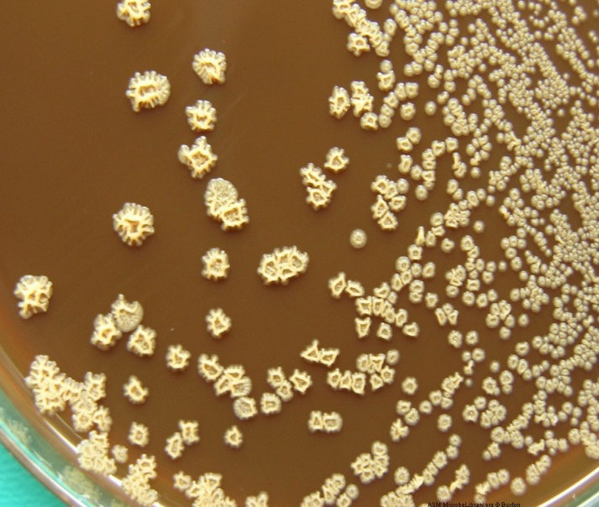

NOCARDIA spp.

Slide 4
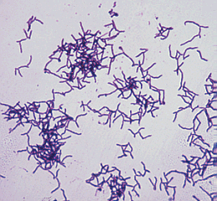
NOCARDIA spp.
Primary cause of Actinomycotic Mycetomas
Most common species: N. asteroides and N. brasiliensis
Rough dry colonies
Fragmenting bacilli
Partially acid fast with Kinyoun stain
Urea (+) and Lysozyme (+)
Virulence factors:
  Superoxide dismutase and catalase
  Nocobactin
Musty odor

Slide 5
NOCARDIA spp.
N. asteroides
N.brasiliensis
Infect through inhalation
Disseminate through the tissue, brain and bone
No sulfur granules
Key reactions:
Casein-negative; tyrosine –negative;
Xanthine-negative; Urea-positive;
Lysozyme-positive; Gelatine-negative
Pulmonary infections (e.g. confluent bronchopneumonia )
Infect through skin and subcutaneous tissues
Common in South America and Mexico
Mycetoma lesions containing sulfur granules
Key reactions :
Casein- positive; tyrosine-positive,
xanthine- negative, Urea -positive
Lysozyme positive ; Gelatine-positive
Cutaneous infections caused by trauma

Slide 6
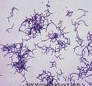
Streptomyces spp.
Long thin hyphae with small oblong conidia
Abundant branching, non-fragmenter
Non-acid fast
White dry to chalky colonies
Odor of freshly tilled soil
Cause mycetomas on the head and neck
Common species S. somaliensis
    Key reactions:
    Casein (+); Tyrosine (+); Xanthine (+); Urea (v);
    Lysozyme (-); Gelatin (+)
(v) = variable

Slide 7
Rhodococcus
Found in soil and dung
Facultative intracellular gram positive dipthroid coccobacilli
Rare branching, partially acid fast
Mucoid colonies -resemble Klebsiella
Mainly a veterinary pathogen; but can be seen in immunosuppressed patients causing respiratory tract infections that can progress to granulomatous pneumonia
Key reactions:
Urea (+); Catalase (+); Camp (+) using Staph.

Slide 8
Actinomadura
Second leading cause of actinomycotic mycetomas
Non-fragmenter, short chains
Found in the soil
Non-acid fast
Forms mycetomas with draining sinuses
Chronically invasive, slowly progressive cutaneous infection
Key reactions:
Casein (+); Tyrosine (+); Xanthine (-); Starch (+);
Urea (-) Lysozyme (-); Gelatin (+); Cellobiose (+); Xylose (+)

Slide 9
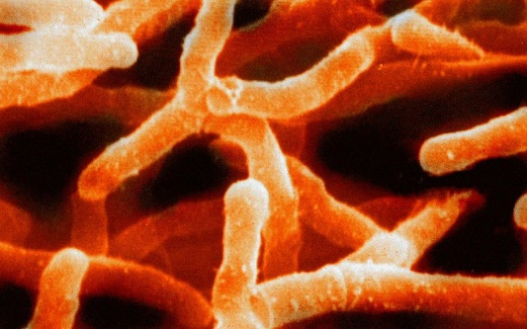
Actinomyces israelii
Normal mouth flora
Cause of actinomycosis-
Produce sulfur granules
Characteristic growth of molar tooth or raspberry appearance
Causes:
Human cervicofacial , thoracic and abdominal actinomycosis; lacrimal canaliculitis , cervicitis and pelvic inflammatory disease associated with intrauterine contraceptive device

Slide 10
Specimen Collection
Best samples are from:
    Puncture wounds, abrasions, drainage, sputum, bronchoalveolar lavage or biopsy (only when clinically necessary).
Routine or special media include:
    Nocardia Differentiation media – used to distinguish
    Nocardia from Streptomyces spp.
    Cadmium sulfate fluoride acriflavine telluride
    (CFAT agar)

Slide 11
Treatment
Drainage, surgery, antimicrobials (e.g. Sulfonamide Erythromycin ,Azithromycin , Clarithromycin ,Ciprofloxacin Vancomycin Aminoglycosides, Rifampin Imipenem)
Antifungal and Beta lactam (ie. penicillin etc.) resistant

