Slide 1

Expenses

Slide 2

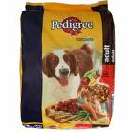

Food
Like humans, dogs need to eat. Generally, dogs feed on dry food. A mixture of wet food and fresh food can be mixed into the diet to nourish the dog better.
Different brands are priced differently. What you get is strongly based on your budget.

Slide 3


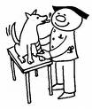
Vet
Dogs will have to have basic vaccinations.
Periodic checkups are strongly advised for dogs as different dogs are more prone to different diseases, especially skin diseases.
Seeing a vet is usually more expensive then seeing a general practitioner.

Slide 4
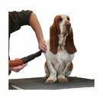

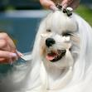
Grooming
How much you spend on grooming depends on the breed of the dog you get.
There are certain parts of grooming that you can DIY, but its best to leave this to the professional groomers.
Dogs also need to have their own toiletries.

Slide 5
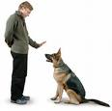


Training
It is best that the dog goes for obedience training for easy handling in the future.
Dogs will enjoy training sessions as it is an opportunity to bond with the owners.
There are many dog trainers out there who are priced differently.

Slide 6
Conclusion
There are cost along the way which owners have to incur to maintain the well being of the dog.
Having a dog is a commitment. How we take care of ourselves should be how we take care of our dogs.
Spend what is needed and you and your dog will have a long a memorable time ahead.

