Slide 1
Moods and Lines in
Artist’s Work

Slide 2
Now that you know:
1. How to draw the different types of line
2. Proper names of the types of line
3. What moods/emotions and adjectives lines portray
Now it is time to put your knowledge to the test.

Slide 3
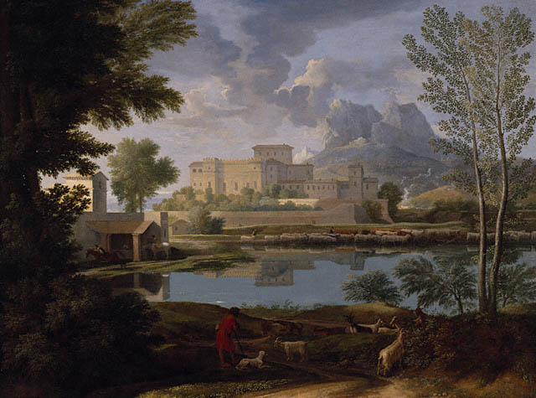
What line type of lines do you see in this picture?
What moods/emotions do you think the lines portray?

Slide 4
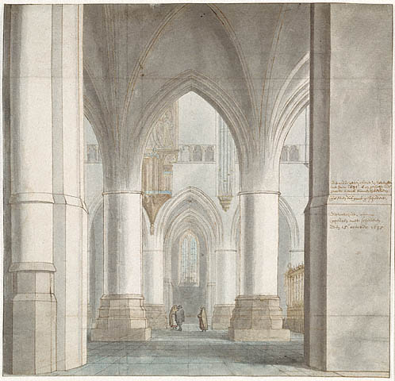
What line type of lines do you see in this picture?
What moods/emotions do you think the lines portray?

Slide 5
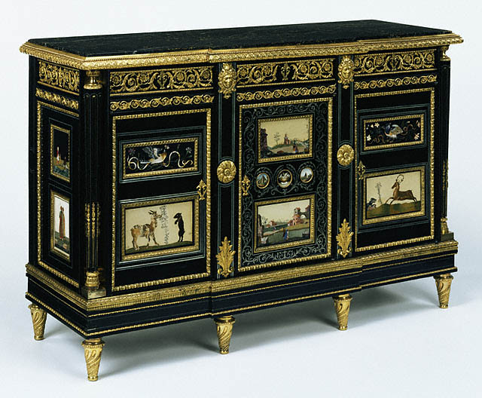
What line type of lines do you see in this picture?
What moods/emotions do you think the lines portray?

Slide 6
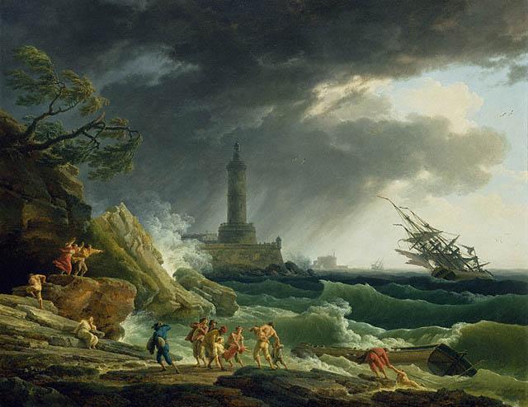
What line type of lines do you see in this picture?
What moods/emotions do you think the lines portray?

Slide 7
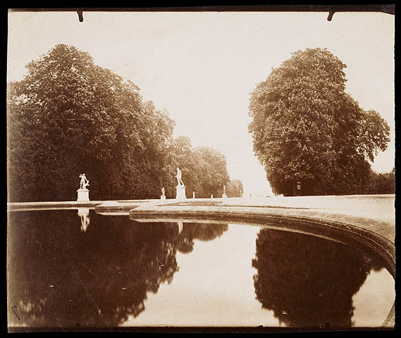
What line type of lines do you see in this picture?
What moods/emotions do you think the lines portray?

Slide 8
The credit for the
Pictures used in this
presentation
go to the
J. Paul Getty Museum
http://www.getty.edu/education/for_teachers/building_lessons/elements.html

Slide 9
Now it is time to talk
About your work……..

