Slide 1
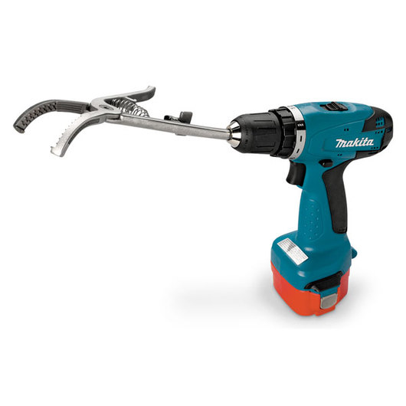
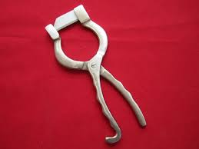
Henderson Tool Castration
Combines the Henderson Tool
+
A variable speed
cordless drill
+
Newberry knife

Slide 2
Why was this method chosen?
This method can be used on bulls of ALL ages
Can be used on older & heavier bulls
Quick and easy to perform
Less traumatic than other methods
Associated with less bleeding and swelling & risk of infection than other methods
Since this is an older, more sexually mature bull, other methods may not be adequate to crush the spermatic cord

Slide 3
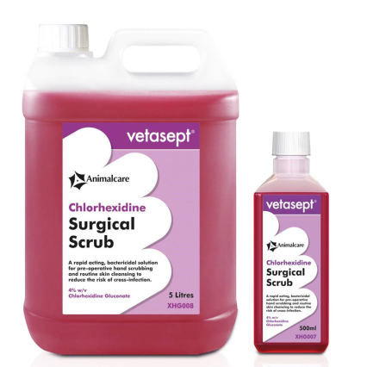
Pre-operative checklist:
Disinfection of all tools (iodine+alcohol solution for 10 minutes)
Restraint of bull in a chute (restrain the tail as well by tying it off to the side)
Sedate the bull
Give local anaesthetic (in the spermatic cord)
Surgical scrubbing of the scrotal sac with chlorhexidine followed by surgical prep with alternating iodine + alcohol
Sterile gloves on
Ready to go!

Slide 4
How it is done:
The testicles are pushed up the scrotal sac. The scrotal sac is then incised (side to side to facilitate drainage) with a Newberry knife.
With the testicles now exposed, one testicle is grasped and 4 inches of spermatic cord is exposed.
Clamp the pliers of the Henderson tool over the spermatic cord (proximal to the epididymis)
Using the drill, rotate the tool, gradually increasing the speed until the spermatic cord is severed (app. 20 rotations) [Keep drill straight and in line with the cord]
Repeat with the second testicle

Slide 5
Video Demos:
Henderson Castration https://www.youtube.com/watch?v=lveKtu1BSIw
Drill Castration for calves, Japanese 243 style (伏見式捻転去勢、Henderson's castration)
https://www.youtube.com/watch?v=jX0gBSsRiOc
HendCastToolCattle
https://www.youtube.com/watch?v=aceVekHiWMw&feature=youtu.be

