Slide 1
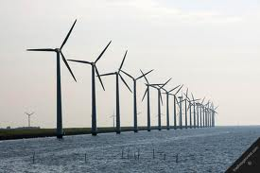

Self-Organization in Energy Smart Grids
Initial set-up for use case description
INTERNE TERUGKOPPELING AAN ZOAS PROJECTTEAM
Hans van den Berg, Peter Heskes, Koen Kok, Frank Phillipson, Max Schreuder, Richard Westerga
11 december 2012

Slide 2
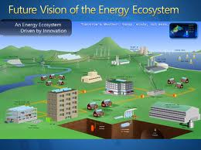
Self-Organization in Smart Grids / why?
Trends
  distributed energy production, also from stochastic energy sources
  new, huge, simultaneously operating loads (e.g. EV, Heat pumps)
  use of flexibility and energy storage options
  lack of technical personnel
  limited capacity of distribution grids
Effects
  more imbalance, more peak loads, faster aging of assets
  harm CAIFI, CAIDI, SAIFI, SAIDI indices
Supporting solution
  Self-Organization in Smart Grids

Slide 3
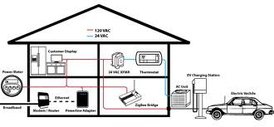
Self-Organization in Smart Grids / actions
Self-optimizing, automatically optimize issues like:
  reduce imbalance using market-based control
  reduce losses by optimize power-flow
  reduce congestion by optimize power-flow
  minimize power transfer
  reduce peak flow
  reduce local imbalance in LV systems
  optimize the size of clustered DER (VPP)
  optimize cost-benefit of the system
Self-healing, automatically isolate and reroute in case of failures like:
  loss of grid components (assets), cables /lines, sensors
  loss of communication
  loss of energy services
Self-configuring, automatically configuring the system during:
  self-optimizing
  self-healing
  isolation of parts of the grid during black-outs

Slide 4
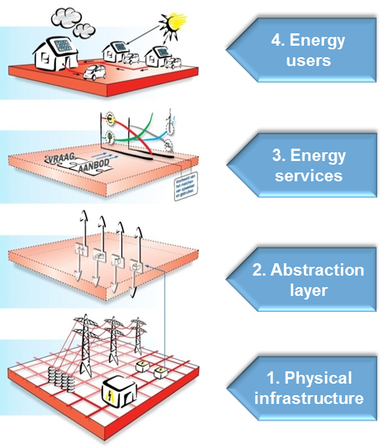
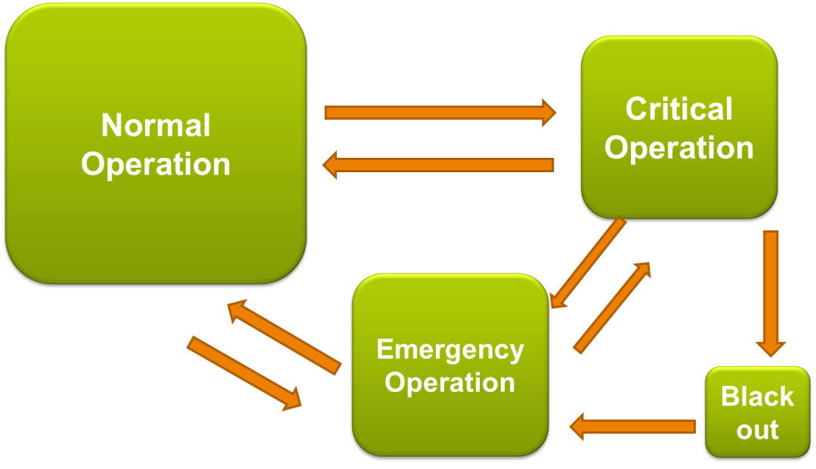
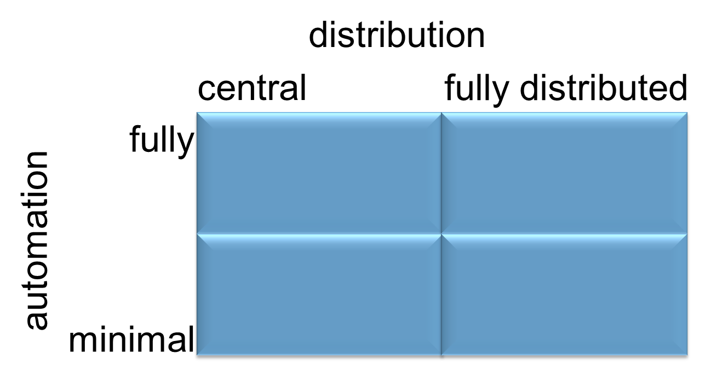
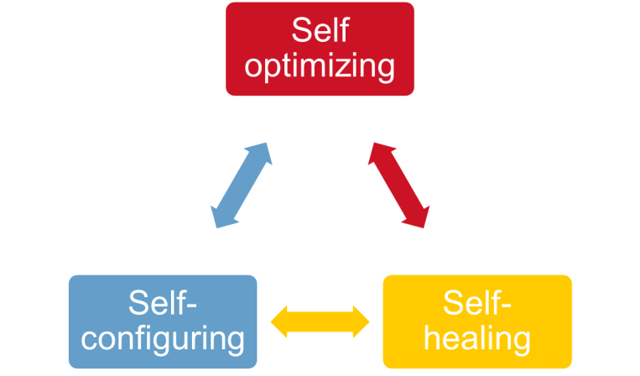
Different views and approaches

Slide 5
Stakeholders
PoNS
SEM
Thema Energie (BL Energie Efficientie)
Netbeheerders (Alliander, Enexis, Stedin)

Slide 6

Existing knowledge and open questions

Slide 7
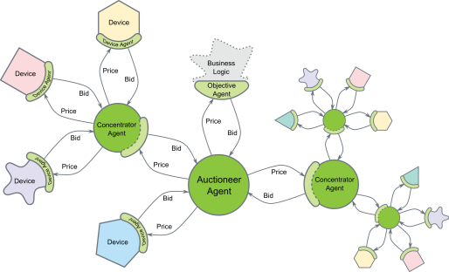
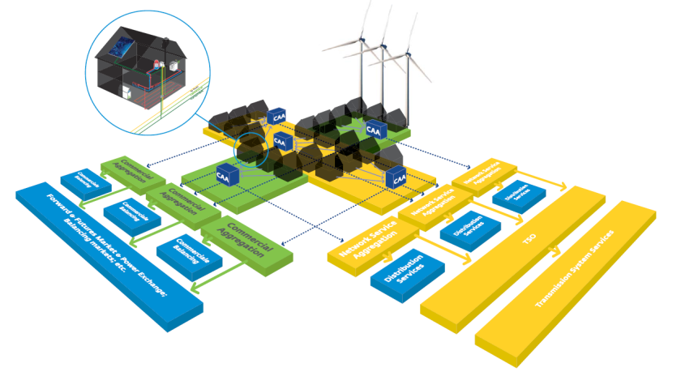
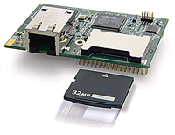
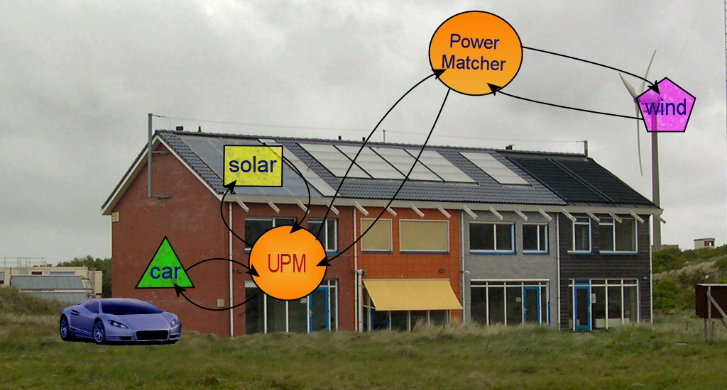
PowerMatcher
Coordination for the Smart Grid
Energy optimization of high numbers small units (<5MW)
Demand Response
Distributed Generation
Storage
(Electrical Vehicles)
Industrial Installations
Domestic Appliances
Business Cases
Energy Trading
Active Distribution
Virtual Power Plant
Imbalance Reduction
Congestion Management
Black-Start Support

Slide 8
Self optimizing in literature – focus on balance supply and demand
Approach in literature:
  EMS (Energy Management System) controls VPP (Virtual Power Plant) and DRR (Demand Response Resources).
  EMS uses mechanisms:
    Direct Control
    Auction/Market based
    Ceiling and budgets
    Dynamic tariffs
  EMS controls group of houses / distributed control
See picture next slide; the EMS is also called aggregator

Slide 9
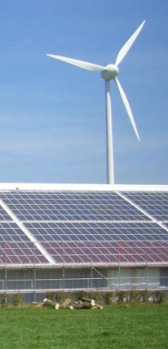

EMS
VPP
DRR
storage
P
C
P
C
P
C
C
consumer
C
C
P
producer

Slide 10
Questions / challenges
Presented approach is distributed, but:
    How do you decide what is the span of control of one EMS?
    Do the EMS’s communicate or is it a hierarchical system?
    Can an EMS act on the ‘imbalance’ market?
    How do you take care of the individual interests of all parties?
    How to cope with disruptions and attacks?
    How to act in various system states?
    Can individual parties make their own decisions, against the system?
    How about islanding?

Slide 11

Roadmap of investigation

Slide 12
Scenarios to investigate
These questions and challenges lead to three interesting scenarios to investigate:
    Hierarchical approach: if there are several aggregators on fixed positions in the network and those aggregators get all the information from the nodes below them and they control those nodes, how does the hierarchical structure work?
    Self-organizing hierarchical approach: location of the aggregator is not fixed, but all ‘nodes’ in the network can adapt this role, reacting on the state of the network. How does the network organize this?
    Self-organizing non-hierarchical prosumers: all the nodes that consumes or produces electricity control only their own behavior, based on the information of the neighbors or peers. No central management level existing.

Slide 13
Approach
All scenarios can be explored incrementally:
  Start with only demand/supply matching.
  Add pricing schemes of the real market and reaction to pricing schemes – including acting on the ‘imbalance’ market.
  Add actors behaviour – how does the system work under compatitive or collaborative behaviour.
  Test on use case: how does the use case (general idea about the near future) fits into this framework?

Slide 14



Use Case Description I
DSO performs active distribution management in order to handle network overload situations and to reduce network losses and sends (price) signals to the prosumers.
ESCOs optimize their position on the wholesale markets and runs a VPP sending (price) signals to their contracted prosumer customers.
(price) signals
End-customer (or Prosumer)

Slide 15
Use Case Description II: Micro-Grid
Electricity Supply becomes unstable, e.g. due to:
Fall-out of a Power Plant
Short circuit
Damage due to digging
Local Network goes into Island Mode and runs through as a Micro-Grid.
Self-organisational issues:
On which level to disconnect? Single building, street, city, region? Bigger is more stable.
Operation of the island: balancing on different timescales.
Bottom-up restoration: Join adjacent islands together to form bigger islands.

Slide 16
Vervolgacties
Verdere uitwerking van inzichten en vastleggen
Vervolg-werksessie met Alliander (Liander Asset Management, afdeling Innovatie)
Betrekken andere netbeheerders via de werkgroep Smart Grids van Netbeheer Nederland (2013)
Vervolgonderzoek i.s.m. marktpartij(en) (2013)

Slide 17
RESERVE SLIDES

Slide 18
A self-optimizing, self-configuring and self-healing energy smart grid
Self-optimizing
  distributed control of demand and supply, driven by an appropriate mechanism, such that (optimal) equilibrium of the system is maintained
    mechanism should provide the right incentives to producers and consumers
    individual (or groups of) producers can decide to increase or decrease production (within certain limits and under some uncertainty)
    individual (or groups of) consumers can decide to postpone or bring forward (part of) their demand
    limited options for storage of energy
Note: the term “optimal equilibrium” requires further specification ….

Slide 19
A self-optimizing, self-configuring and self-healing energy smart grid
Self-configuring
  Additional producers and consumers can be ‘seamlessly’ integrated (i.e. new and existing ‘participants’ adapt their behavior automatically to the new situation, and the system shifts to a new optimal equilibrium)
    similar requirements when producers/consumers are ‘removed’ from the system
Self-healing
  The system adapts automatically (‘as good as possible’) to failure of one or more energy producers and/or energy transport facilities → new optimal equilibrium

Slide 20
Self optimizing
Self-healing
Self-configuring

Slide 21
Use Case Description – Stakeholders I
End-customer (or Prosumer): traditionally the end-user of electricity, now has become a net producer of electricity at times. In the smart grid the end-customer will deliver services to this ESCO and to his DSO: flexibility, fast reactions to network disturbances, reactive power, etc. This flexibility is delivered through:
  Distributed Generation (DG): Electricity producing units connected to the distribution grid.
  Demand Response (DR): Electricity consuming devices that are able to alter their operations in response to external (price) signals.
  Distributed Storage (DS): energy storage devices connected to the distribution network able of bi-directional exchange of energy with that network.

Slide 22
Use Case Description – Stakeholders II
Energy Service Company (ESCO): traditionally the supplier of electricity, now also buys electricity from his customers and in the smart grid buys a flexibility service from them. Is active on the wholesale markets for electricity where it can create value from flexibility.

Slide 23
Use Case Description – Stakeholders III
Distribution System Operator (DSO): Operator of the distribution grid. Traditionally passive operation. In the smart grid it involves systems of/at end-customers in active distribution management. Thus, the DSO buys services from the end-customer: flexibility services, , fast reactions to network disturbances, reactive power, etc.
Transmission System Operator (TSO): Operator of the transmission grid. Obtains (buys) grid support services from the DSO.

Slide 24
Use Case Description – Normal Operation
ESCOs optimize their position on the wholesale markets on a time scale of 1 to 15 minutes. Instant reactions are based on the situation on the imbalance market. For this, each ESCO runs a Virtual Power Plant (VPP) sending (price) signals to their contracted prosumer customers. Through the imbalance market and the ESCO’s VPPs, the DG, DR and DS at end-customers react to fluctuations in the availability of central renewable generation.
On the same time scales, the DSO performs active distribution management in order to handle network overload situations and to reduce network losses. In case of network overloading, the DSO sends (price) signals to the prosumers, additional to those sent by the ESCO’s VPPs. Local aspects in balancing demand and supply are taken into account only if network capacity is insufficient (overloading, congestion) and to signal costs for network losses to connected prosumers.

Slide 25
Considerations regarding the behavior of the system
(Price) signals from ESCOs and DSOs are competing for the same ‘resources’
  and: prosumers of different ESCOs may be connected to the same network, which further complicates the situation
Suppose that all actors are intelligent, e.g. prosumers do not only take into account current prices (consumption, generation), but also the expected prices in near future and the flexibility in their consumption (and generation).
In an ideal situation the behaviour of the actors should ‘automatically’ adapt (in an ‘globally optimal’ way) to changes in the system
Fully distributed approach (robustness!?) ←→centralized approach (vulnerable!?)

Slide 26
Considerations regarding the behavior of the system
What about a fully distributed approach, i.e. ESCOs and DSOs act independently of each other (no direct coordination) maximizing their own utility, while prosumers maximize their utility based on the (price) signals from ESCOs and DSOs (+ estimates of future prices, etc).
  Would this lead to a ‘stable’ solution? Oscillating behaviour?
    what are the resulting strategies/decision algorithms of each of the actors?
If a fully distributed approach is not feasible: which interaction between ESCOs and DSOs is then minimally needed to achieve ‘stability’?
  And what about the (price) signalling strategies of ESCOs and DSOs, and the decision strategies of the prosumers?
  Is it needed that the ESCOs and DSOs can overrule the (‘autonomous’) decisions of the prosumers?

Slide 27
Use Case Description – Emergency Operation
Local parts of the network run ride through the emergency in islanded mode, disconnected from the rest of the grid.
  On which level to disconnect? Single building, Low-voltage feeder, City, Region? Bigger is more stable
  Within the island: use Distributed Storage for fast (primary) balancing, other flexibility (DG & DR) for secondary balancing.
  Join adjacent islands together to form bigger islands.
  When to reconnect and return to normal operational mode?

