Slide 1
ZOAS
Stress – immune responsiveness - microbiota
In calves

Slide 2
Problem
Widespread antibiotic overabundant use in farming.
Use of antibiotics results in resistant microorganisms.
Resistant microorganisms spread via food/environment to humans and eventually the clinic.
Antibiotic resistance hampers treatment of common infectous diseases.
Agriculture needs to find better practise to decrease need for antibiotics use.
Issue recognized worldwide and urgent for Dutch farmers.

Slide 3
Possible solution
No easy “one size fits all” solution.
Prevention is key.
Infections often arise from increased vulnerability of the animal and rapid exchange between animals.

Slide 4
ZOAS challenge
Can we strengthen the natural defenses of the animal to cope with stressful challenges of todays farming conditions.
→Deploy the self-organizing properties of the indigenous microbiome

Slide 5
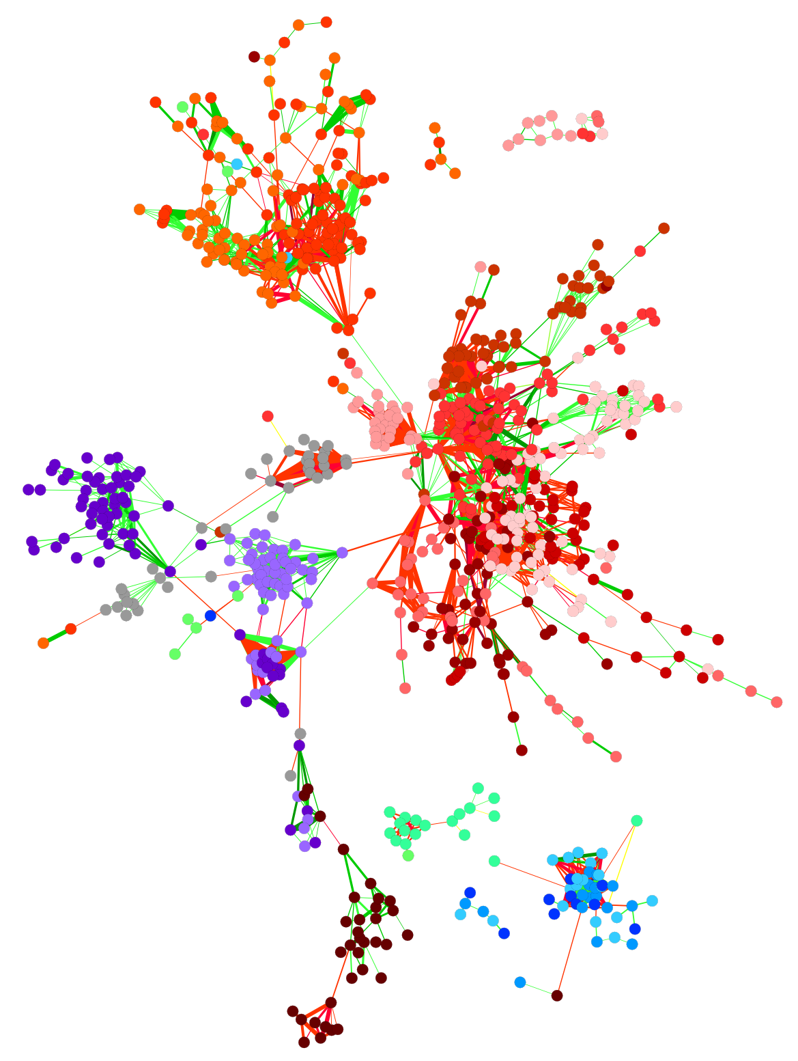
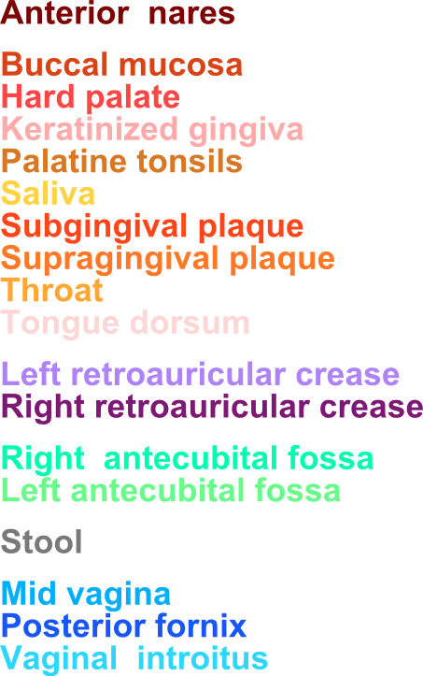
Friends, neighbours, and enemies: Microbial co-occurrence and exclusion in the human microbiome
Co- Anti-
http://huttenhower.sph.harvard.edu/

Slide 6
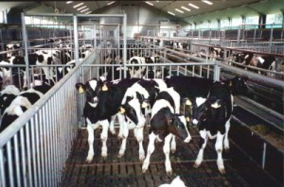
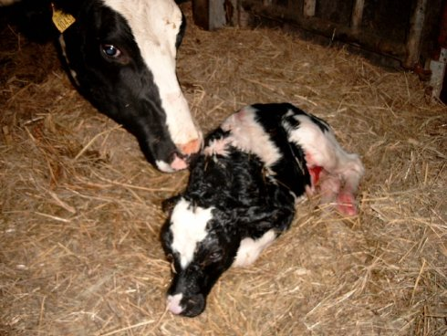
ZOAS case: Shipping fever in calves
Shipping fever: symptoms of dripping noses, fever, diarrhoea occurring in calves just after transport and arrival at breeder.
90 – 95% of all calves receive antibiotics due to shipping fever

Slide 7
Shipping fever – stressing challenges
Premature immunity
Rapidly changing environment:
New pathogenic challenges
Premature microbiome
Anxiety:
Fear / Exhaustion
Pathobionts

Slide 8
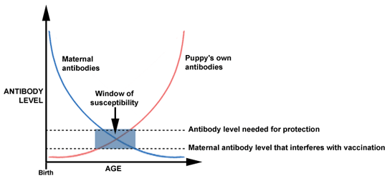
New-born gains immunity from the mother in the first weeks
Reflect local environmental pathogens.
Provides immunity during development calf own immune system.
Calf owns antibodies

Slide 9
Shipping fever – stressing challenges
Premature immunity
Rapidly changing environment:
New pathogenic challenges
Premature microbiome
Anxiety:
Fear / Exhaustion
Pathobionts

Slide 10
Shipping fever – current solution
Antibiotics

Slide 11
Shipping fever – ZOAS solution
Premature immunity
Rapidly changing environment:
New pathogenic challenges
Premature microbiome
Anxiety:
Fear / Exhaustion
Pathobionts

Slide 12
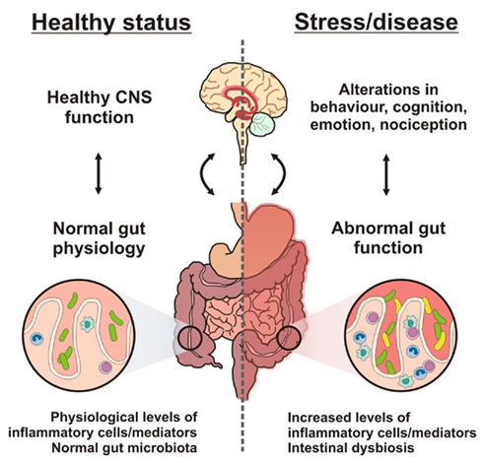
Stress and microbiome – a causal interplay

Slide 13
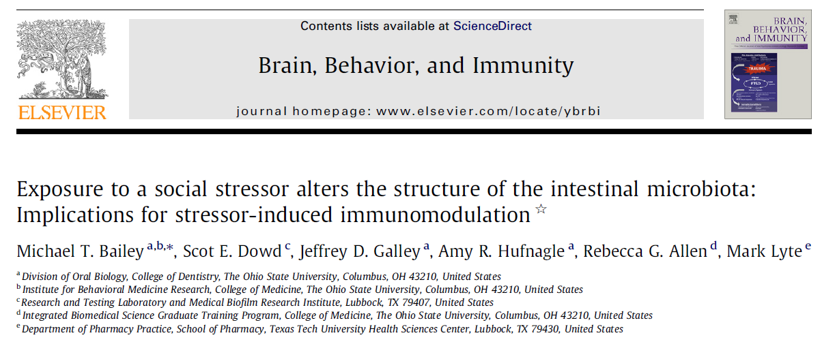
Stress and microbiome – a causal interplay

Slide 14
Stress and microbiome – a causal interplay

Slide 15
Microbial environment
at farmer
Immune responsiveness compromised
Microbial
Environment at breeder
pathogenic (over)growth
balance
balance
Healthy immature immune responsiveness
Healthy mature immune responsiveness
Notes:
Pictures needs to be improved. Lacking inspiration right now.

Slide 16
Solutions for Shipping fever in calves
“Simple” solution: do not ship, leave calf with mother and in its environment until immunity / microbiome has developed and eat less meat.
Or – Strengthen the natural defenses of the animal to cope with stressful challenges of todays farming conditions.

Slide 17
SOAS: microbiota–immune responsiveness stay in balance
Identify prime network factors that cause / prevent dys-balance
Relation of illness symptoms (calf) to stress/anxiety (calf) and pathogenic load (environment)
Read out:
Microbiota (metagenomics)
Immune, Stress and Neurochemical markers
Possibility prevention dys-balance
Multivariate machine learning to determine biomarkers for balance microbiota – immune responsiveness calf
Predict which factors can be changed (e.g. transport, housing or feeding schemes) dys-balance of immune responsiveness –microbiota?

Slide 18
Balancing the project workpackage cost
Cost acquiring data
Cost model development
Link to existing projects and use available data as much as possible

Slide 19
Alliances
SKV and SDA: infocalf - data on calf drug therapies.
PPS (Van Drie / Friesland Campina / UMCU / TNO) Sharing data on respiratory tract and gut microbiota and origin calf
Environmental microbial factors - SKV?

Slide 20
Deliverables
Model and appropriate biomarkers on (factors influencing) the self organizing and autonomous system ‘microbiota – Immune responsiveness’.
Link anxiety to microbiome structure.
Identification of most relevant environmental factors that affect microbiome.
Industrially relevant strategy to keep microbiome system in balance.

Slide 21
Industrial relevance
Need to reduce use of antibiotics in veal industry in the Netherlands and elsewhere.
Economic benefit can be gained from eliminating antibiotics.
Opportunities for feed producing companies.
Approach for calf shipping fever is generic and can be adopted for use in pork and chicken farming.

