Slide 1
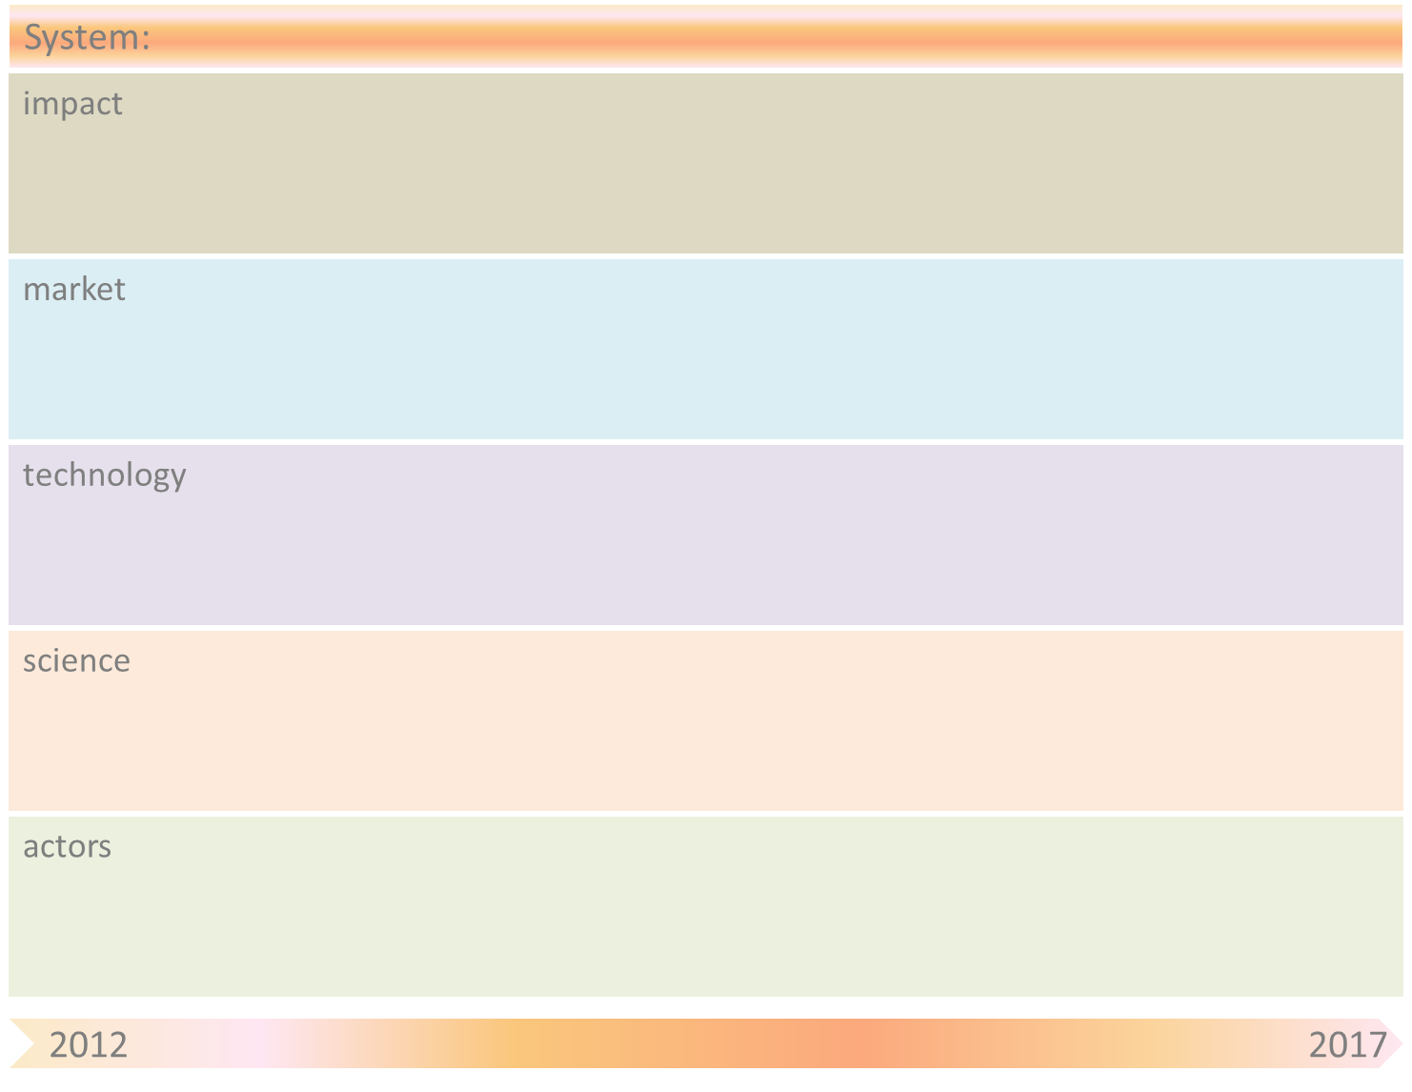
Cyber Security
Increasing social/economic impact of Cyber Crime due to ever increasing dependence of economy/society on ICT
Cyber Crime becomes more and more ‘professional’, also used for military and political goals --> Cyber Warfare, Cyber terrorism
Increasing effort (and money) dedicated to fighting Cyber Crime --> Cyber Security
Direct economic damage decreases due to a safer cyber environment
Indirect economic growth due to more societal confidence and more (international) economic activity.
Coalition forming of organizations and countries in order to fight Cyber Crime.
Need for new regulations concerning political, safety and privacy issues
Currently
Detection of known attacks (based on ‘fingerprints’ and ‘signatures’).
Follow-up measures are triggered ‘manually’.
2020
Organizations automatically detect, collect and share suspicious patterns --> new attacks are quickly recognized and spreading of the attacks/viruses can be prevented.
Timely, automatically triggered follow-up measures when attack is detected.
Currently
Detection algorithms for known attacks are further improved. Design of (static) ‘sensoring’ architectures, in particular dealing with scaling problems. Initial work regarding ‘self-learning’ concepts in, e.g., detection.
2020
Increase ‘self-learningness’ of detection methods (‘self-insight’) --> new types of attacks can be recognized automatically.
Develop flexible, ‘self-learning’ sensoring architectures --> self-organising system for collection and exchange of sensor data among trusted institutes; Design self-learning algorithms for determining and executing follow-up actions.
Attackers/hackers: private, organized crime, Defense, Secret service, …
Victims: Banks and other (large) companies, Defense, Government, AIVD, Health facilities, …
Solvers: IT firms, systems integrators, TNO, academia, mediators, ..

Slide 2
System-name: Cyber Security
Drivers/ Breakthroughs | Mitigation by SOAS principle(s)
Increasing complexity of control (due to increasing complexity and scale of attacks and increasing complexity of the involved networks/systems). Manual control is no longer good enough (and becomes too expensive). | Faster and more adequate detection and resolution of cyber attacks. Cost reduction in fighting cyber crime through reduced need for human involvement.

