Slide 1
SOAS Roadmaps Template (in English please)
Instructions:
Collect existing roadmaps in ‘your’ domain (logistics, biology, com-networks, organization-work, organization-collaboration, ict -people)
Choose relevant existing roadmap
Make a copy of slide#2 and slide#3 and insert
Define the system-name and system-goal the roadmap is about
For each horizontal bar (actors, science, technology, market, impact) formulate the development in terms of keywords (use copies of the “item” [ctrl+d]) see also explanation of the dimensions
After all keywords are in place, add key obstacles (use copies of “obstacle” [ctrl+d])
When done, return to step 2 until all relevant roadmaps are made
Save file with domain name in the file name (eg. logistics zoas rm v01.pptx)
Place in following folder \\tsn.tno.nl\data\Projects\041\0\01077\ZOAS knowledge\roadmaps
Think ‘hallelujah’
Explanation of the dimensions:
Actors:
For this dimension name the relevant actors involved with the system and how they are linked and how this network develops through time.
Science:
Name the actual and expected scientific principles involved.
Technology:
Describe the technological development , the actual practical application of science now and expected.
Market:
Name the relationships between producers and consumers (a-b) that benefit from the system, now and expected
Impact:
Name the consequences of the emergent system behavior, positive and negative

Slide 2
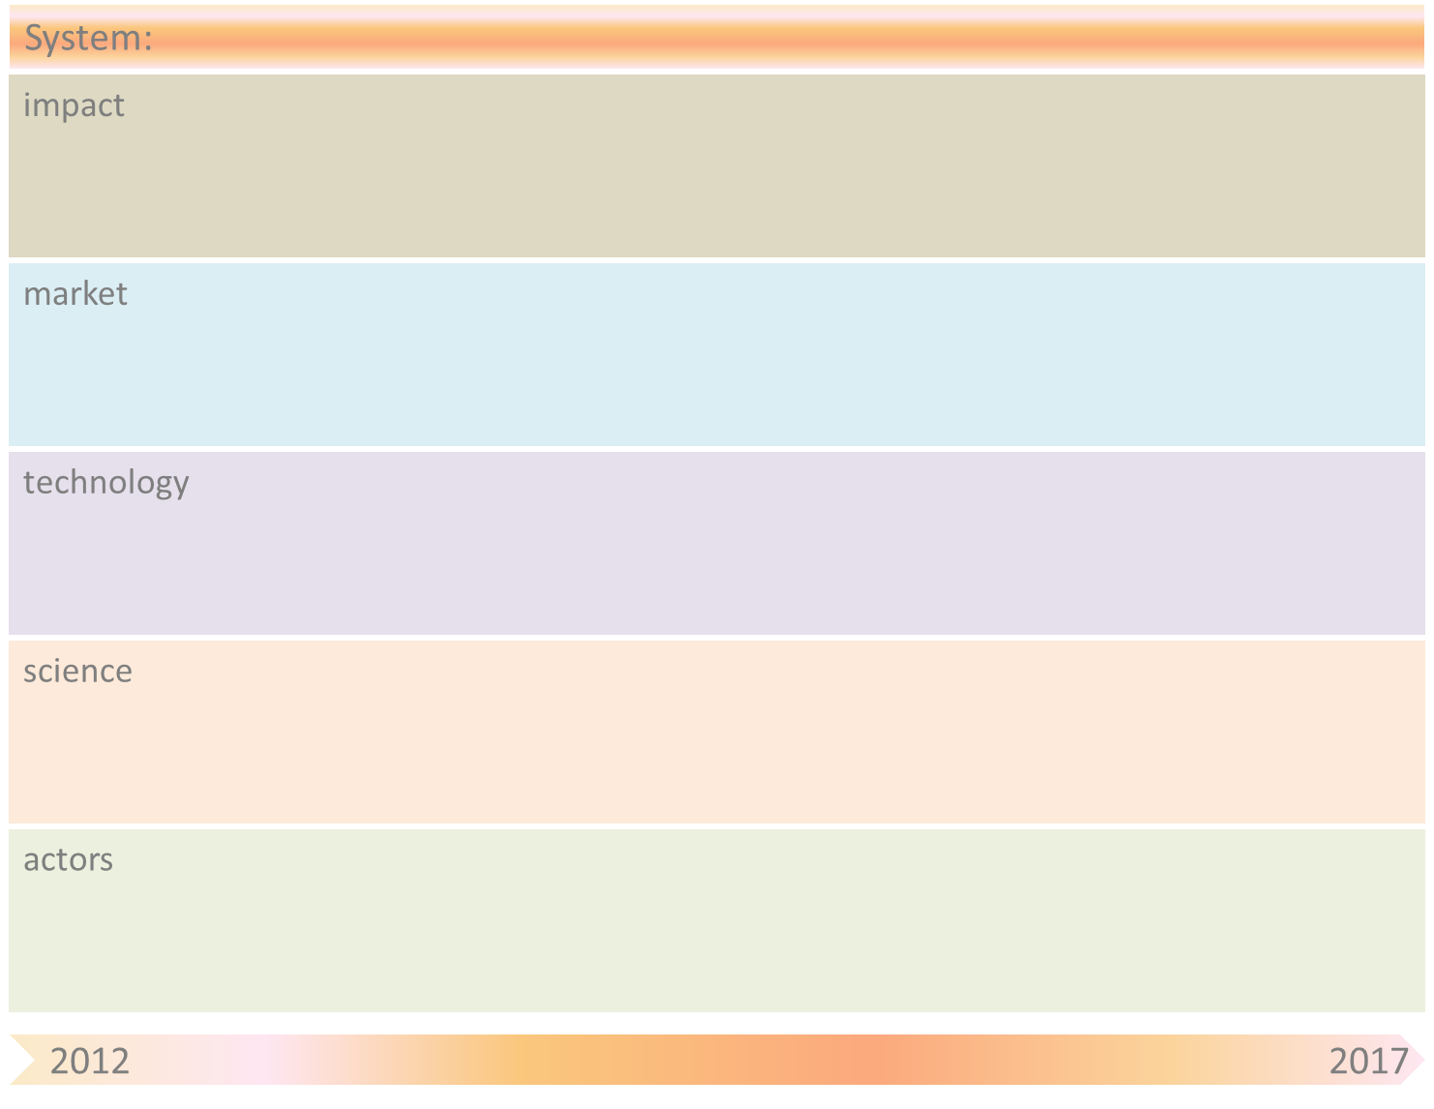
TNO: generating & facilitating breakthroughs with SOAS
item
managing entities
managing relationships
obstacle
loss of control
paradigm
shift
unfair
degraded ecology
fair
enhancing ecology
fear
challenge
unconscious consumer
conscious consumer
short term wins (for some)
paradigm
shift
long term gains (for all)
unsustainable
sustainable
multiple perspectives
actor/social networks
augmented reality
data mining
relationship mining
agent based models
network representation
enhanced connectedness
high fidelity avatars
cloud computing
knowledge networks
universal translator
agent based modelling
genomics
super conduction
system theory
network theory
nano-tech
brain-machine interfacing
mono disciplinary
behavior - physiology
machine intelligence
business developers
∆behavior
paradigm
shift
managers
problems
clients
researchers
clients
expertize managers
business developers
researchers
managers
managing entities
managing relationships

Slide 3
System-name
Obstacle | Mitigation by SOAS principle(s)

