Slide 1
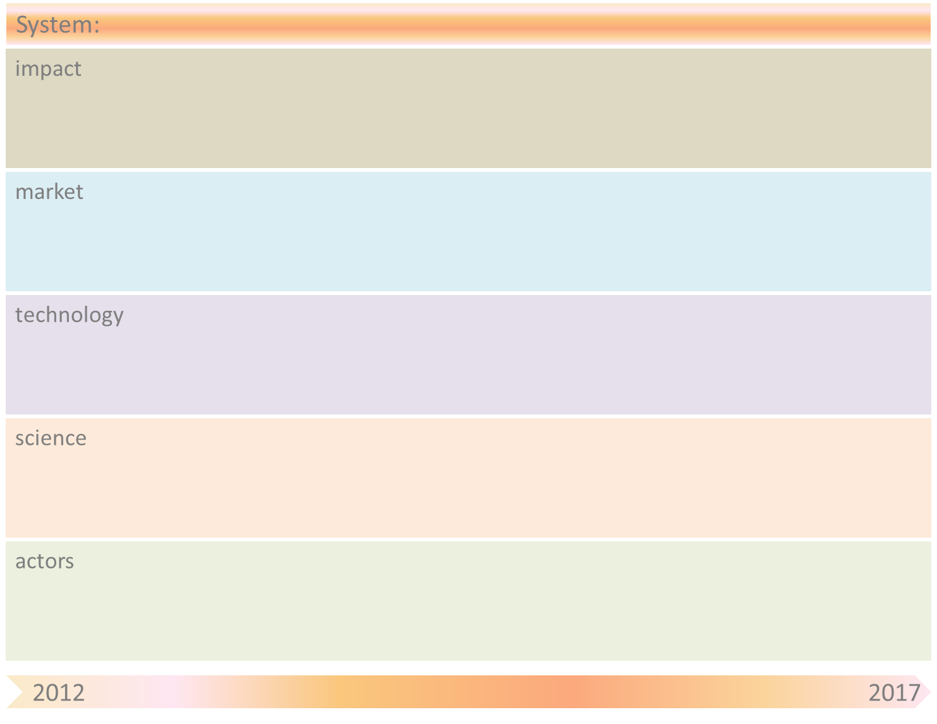
system-name & system-goal
: Human Capital Agenda & Social Innovation in Dutch top-sector policy
item
better use of talents and creativity
optimal valorisation, productivity, competitiveness and good quality of work: upscaling to systemic innovation
obstacle
lack of valorisation
setting up new networks and nodes
finetuning institutions: knowledge institutions, educational institutes, social partners
effective colllaboration in networks to improve market opportunities,
market driven innovation
missing opportunities
too strong a focus on economic and technological innovation / R&D investments
paradigm shift: integrating social and technical and economic innovation
human factor is limited to labour market issues and technical education
more attention for added value of ‘soft’ skills
paradigm shift: including the social dimension, networks and ‘soft’ skills
receptance of complexity perpective and non linear management models
better understanding of emergence and self organizing in the management context
dominance of rational choice model
lack of cooperation between stakeholders
developing networks
new business models: full cost pricing
co-creation, co-production as emergent patterns of self organizing

Slide 2
System-name
: Top sectoral innovation & social innovation
Obstacle | Mitigation by SOAS principle(s)
Innovations too often fail or become limited in scope due to not taking socio-organisational aspects (social innovation) into account | Roadmaps: Innovation-contracts and human capital agenda’s op the top sectors; TNO High Road project, TNO ETP Behaviour & Innovation, TNO propositions Sustainable Participation and Sustainable Productivity SOAS principles from theories of social complexity take as a point of departure the highly unpredictability of outcomes produced by local interactions, in the case of many actors and complex interrelating in the striving for certain goals. Human local interactions, however, produce global (aggregated) patterns, that may be somewhat predictable between a certain bandwidth and with the help of scenarios. This scenario-method can be applied to a large variety of domains, for example, systemic innovation with open access, individualisation within social security, innovation through networks of small companies and individuals, decision making in financial markets. The main question to be researched is how innovation in top sectors can be more successful with a better understanding of the social dimension. Can global patterns be detected in, for example, innovation networks, innovation teams, innovation regions?
No systemic, integral innovation | Combine drivers (uplifting factors), pull factors/demands (system attractors), push factors/supply (knowledge, networks), take away barriers (drag factors) and facilitate platforms, scenario thinking, nodal points, connect people/stakeholders

