Slide 1
Adaptive tour planning system: storyline
Tour planning is now rather static, i.e. pre-planned and difficult to change. This makes it difficult to respond to changes in traffic and changes in freight assignments.
Currently there is limited central tour re-planning at daily basis, en-route reassignment is arranged by phone or on board unit, with limited or no re-planning of tours, let alone interaction between tours. Experiments with RITS and PAT.
If real time information is used about supply (changes in travel time) and demand (changes in freight volume), tour planning becomes dynamic and adaptive. Moreover, collective planning can be driven by information and action at the lowest units (trucks) instead of central planning agency.

Slide 2
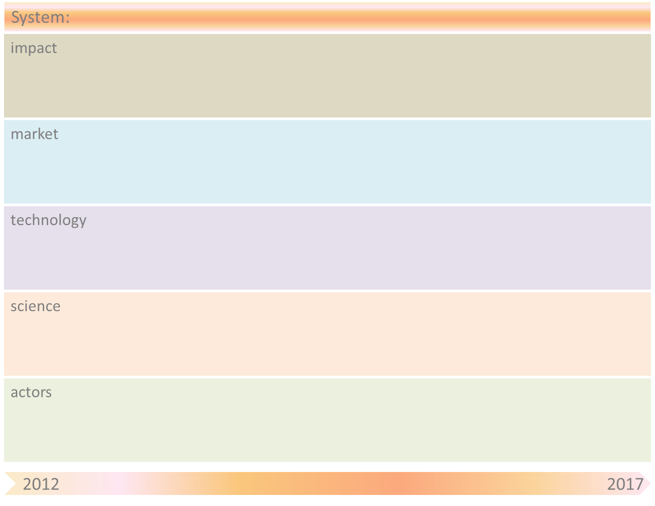
Adaptive tour planning system
Shorter delivery times
Better vehicle capacity utilization for carriers
On-board systems for carriers
Planning systems for carriers
Dynamic planning
Agent-based technology for carriers
Collaborative planning tools
Artificial Intelligence
Cloud computing
Computer Supported Collaboration
Universities (e.g., TUDelft/Utwente/Uni Bremen)
& Research Institutes (e.g., TNO/CRC637)
Carriers
(RITS/PAT)
On-board systems providers
Transport Service
Clients
Planning systems providers

Slide 3
Adaptive tour planning system
Obstacle | Mitigation by SOAS principle(s)
High transaction costs, difficulty of coordination and risk of information leakage with central planning | Decentral planning, responsibilities assumed at lowest level, agreement on information exchange between actors

