Slide 1
Self-organizing parcel delivery system: storyline
There is a growing market for responsive/flexible parcel deliveries; SOAS are part of the answer of how to improve these systems
LSP’s are already working on these systems, questions relate to the availability and price of tech (active RFID) and architectures (Efreight) especially for public facilities

Slide 2
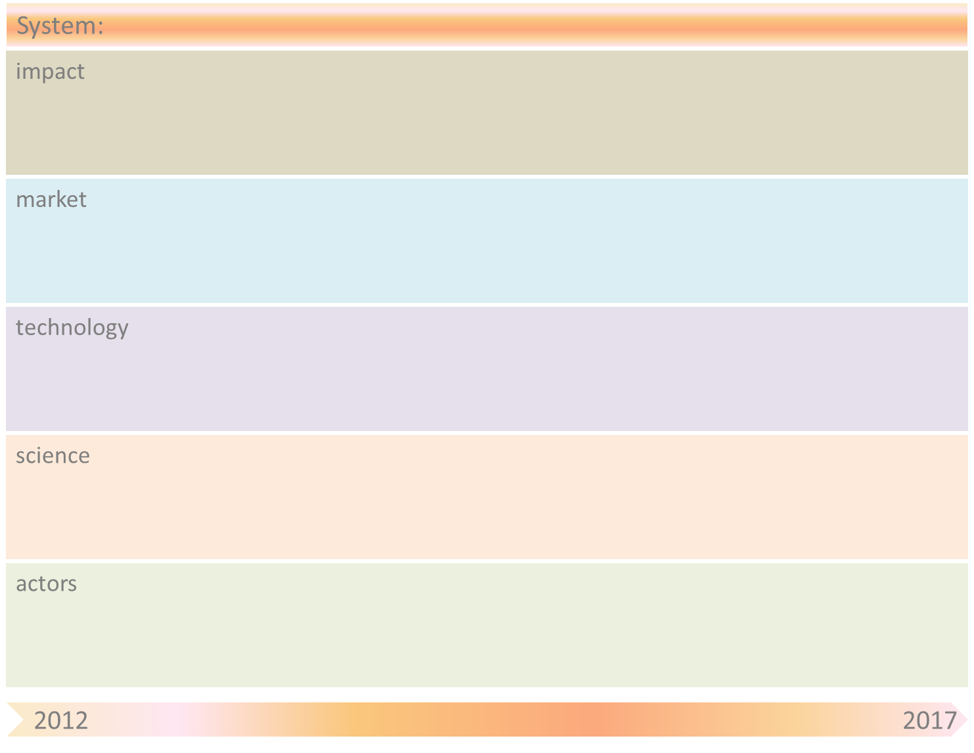
Self-organizing parcel delivery system
Increased responsiveness and flexibility
Increased robustness
Customised parcel delivery
Container services
E-commerce (B2B & B2C)
Parcel services
Quality control & security for customs
RFID technology for parcels
URI & semantic web technologies
Algorithms for agent-based parcel routing
Cloud computing
Sensors & sensor networks
Ubiquitous computing
Distributed computing
Artificial Intelligence
Sensors suppliers (e.g., ASML)
& sensor applications developers
Universities (e.g., TUDelft/Utwente/Uni Bremen)
& Research Institutes (e.g., TNO/CRC637)
Global Integrators
(e.g., DHL/K&N/UPS)
Universities (e.g., TUDelft/Utwente/Uni Bremen)
& Research Institutes (e.g., TNO/CRC637)
Global Integrators (e.g., DHL/K&N/UPS)
Small Logistics Providers
Global Integrators (e.g., DHL/K&N/UPS)
Small Logistics Providers

Slide 3
Self-organizing parcel delivery system
Obstacle | Mitigation by SOAS principle(s)
Sensors and RFID technology costs | We aim at providing eventually even the smallest parcels with smart sensors in order to store/process information. Costs of sensors and RFID technology are still too high.
Scalability of agent technology | Agents are necessary in a decentralized architecture to process locally the relevant information coming from RFID tags, and take decisions based on this information. Are agent-based solutions scalable for huge amounts of parcels to be delivered?
Granularity level of agent-based solutions | Where the agents should be for optimal and scalable solutions? E.g., (ordered from low to high granularity) parcels, packages, containers, vehicles, hubs, etc.
Reusability of technological solutions | To what extent can technological solutions, such as sensors and agents, be reused? E.g., products (no reusability), packages (low reusability), containers (good reusability) , vehicles (high reusability)
Communication issues | We can provide IT solutions to improve communication and information sharing using web technologies and so forth, but are stakeholders willing to provide and share this info?

